Slide 1
POS Tagging

Slide 2
Introduction
POS Tagging is used to tag part of sentences.
Noun, Verb, adjectives, Prepositions, adverbs etc. are tagged to words.

Slide 3
Classes
Open class- such as nouns, verbs. e.g. iPhone
Closed class- such as prepositions

Slide 4
Parts of Sentence
Prepositions- on, at, from
Determiners- a, an, the
Conjuctions- and, or
Pronouns- I, He

Slide 5
Techniques
Rule-based
Stochastic based(Probability)

Slide 6
Rule-based
NP->N
N->Book
S->NP VP
NP->N
N->book

Slide 7
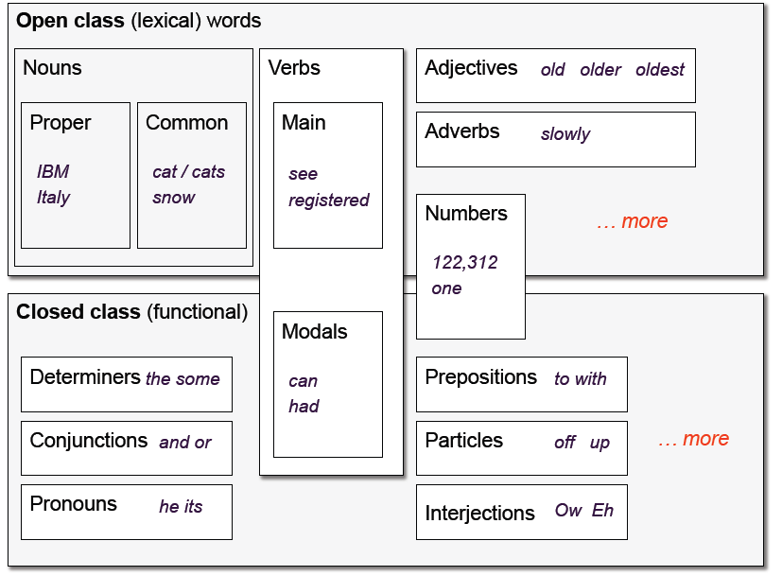

Slide 8
Stochastic based
In this technique, probability is assigned to every word.
Term Frequency
Position of words

Slide 9
Example
I want to book a flight
I want to read a book.
V->Book
N->Book

Slide 10
I want to book a flight.
Book as verb- 100
Book as noun- 50
(v|preposition)= 100
(n|preposition)=20

Slide 11
He Flies like flower
P(N|N)=0.13
P(V|N)=0.43

Slide 12
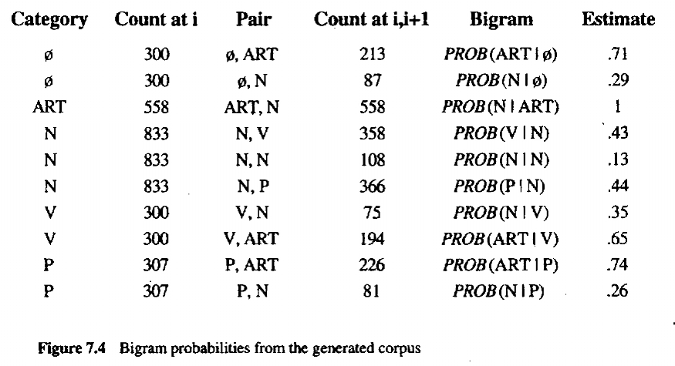
Source : J Allen book

Slide 13
1. | CC | Coordinating conjunction | 19. | PP$ | Possessive pronoun
2. | CD | Cardinal number | 20. | RB | Adverb
3. | Dl’ | Determiner | 21. | RBR | Comparative adverb
4. | EX | Existential there | 22. | RBS | Superlative Adverb
5. | FW | Foreign word | 23. | RP | Particle
6. | IN | Preposition / subord. conj | 24. | SYM | Symbol (math or scientific)
7. | 11 | Adjective | 25. | 10 | to
8. | JJR | Comparative adjective | 26. | UH | Interjection
9. | JJS | Superlative adjective | 27. | VB | Verb, base form

Slide 14
10. | LS | List item marker | 28. | VBD | Verb, past tense
11. | MD | Modal | 29. | VBG | Verb, gerund/pres. participle
12. | NN | Noun, singular or mass | 30. | VBN | Verb, past participle
13. | NNS | Noun, plural | 31. | VBP | Verb, non-3s, present
14. | NNP | Proper noun, singular | 32. | VBZ | Verb, 3s, present
15. | NNPS | Proper noun, plural | 33. | WDT | Wh-determiner
16. | PDT | Predeterminer | 34. | WP | Wh-pronoun
17. | POS | Possessive ending | 35. | WPZ | Possessive wh-pronoun
18. | PRP | Personal pronoun | 36. | WRB | Wh-adverb

